Slide 1

Lord’s Eye
Identifying road defects from dashcam videos
Team Code Blooded

Slide 2



The Problem
Increasing traffic due to deplorable road conditions
Worn out road markings causing accidents
Worn out road marking identification process is manual and arduous

Slide 3
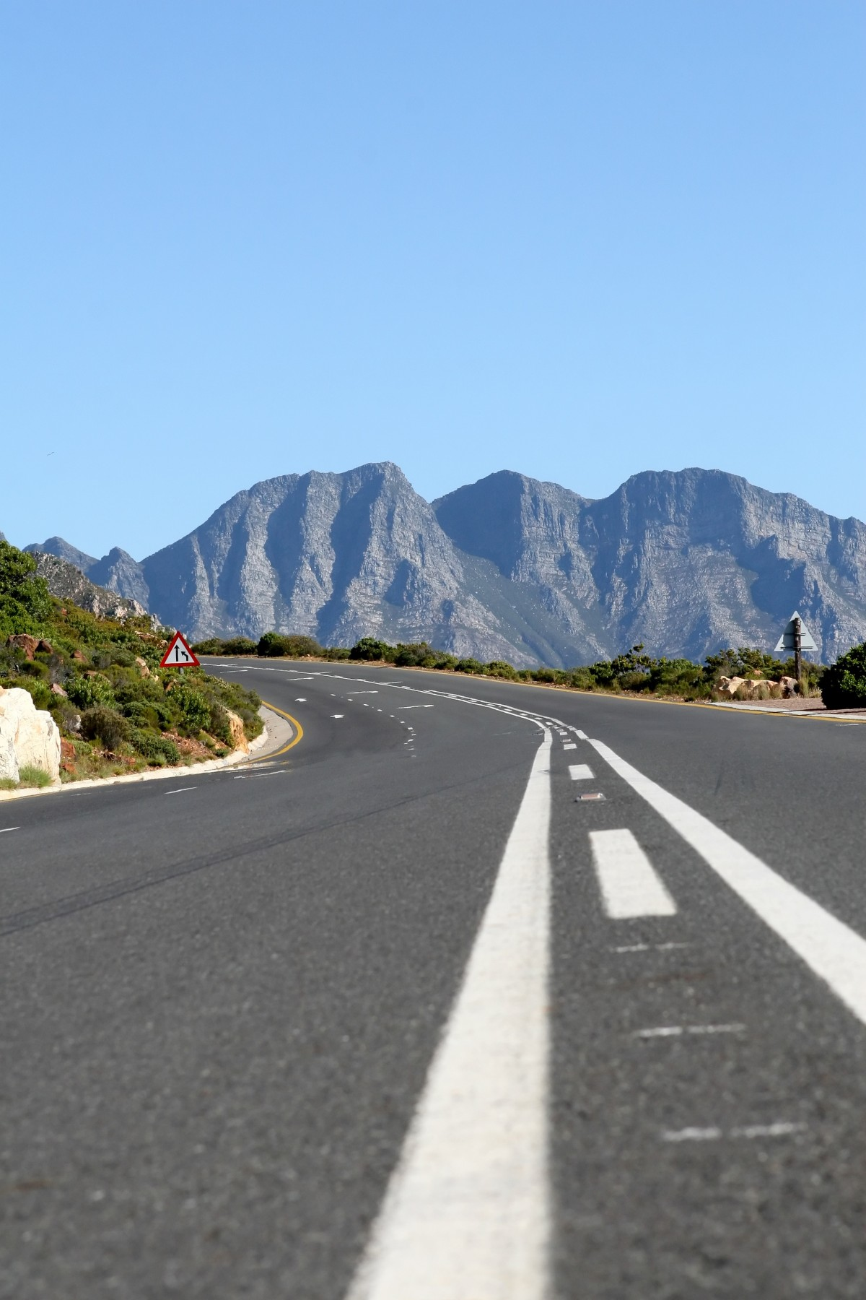



Solution
Leveraging the thousands of cars plying down the same road to get data
Use of dash-cam video footage to identify worn-out road markings and potholes
Storing location coordinates of such places with potholes and worn-out road markings

Slide 4
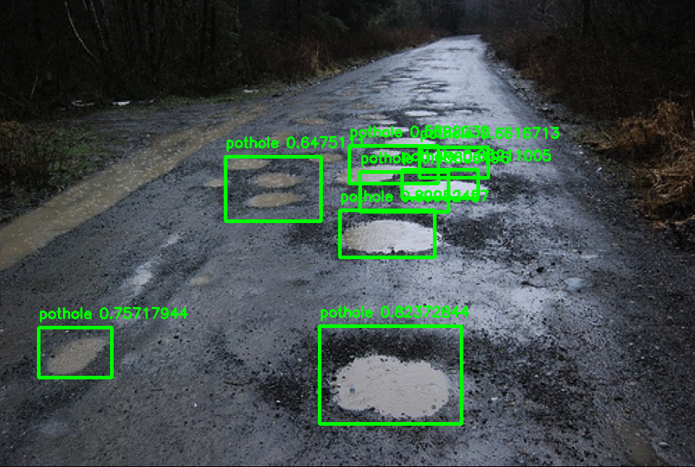

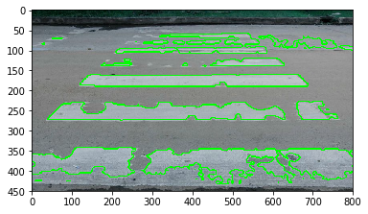
Lord’s Eye : How it works?
Dash-cam videos and location coordinate samples from cars are uploaded on the server
The Server houses an AI and computer vision based model for worn-out lane marking identification

Slide 5

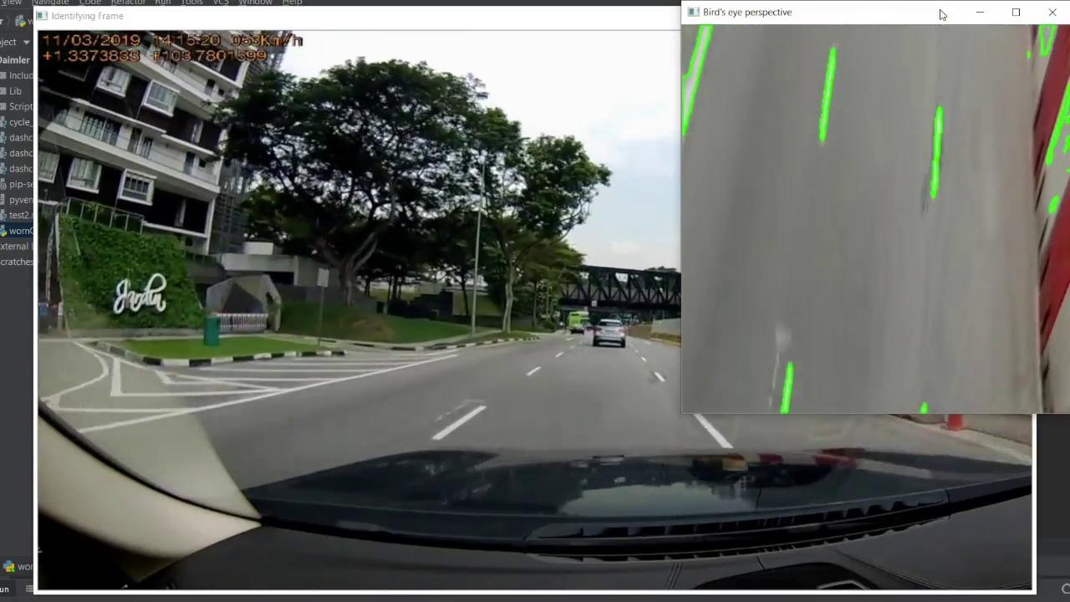
Demonstration

Slide 6

Beneficiaries
Local Government authorities
Car insurance companies
Autonomous vehicle manufacturing companies

Slide 7


ROADMAP
Processing the worn out markings to predict degradation percent (In progress)
HackAsia
Detect pothole and worn out markings
Identifying other critical road defects
2019
2021
2020
Next
Perspective transformation for better detection of worn out lane markings
Real Time processing of the different types of defects for quick alerts

Slide 8


CodeBlooded

